Slide 1
JSON
JavaScript Object Notation
Notes:
https://www.youtube.com/watch?v=JuFdz8f-cT4
https://www.youtube.com/watch?v=wI1CWzNtE-M
https://www.youtube.com/watch?v=chRxJhWLBMM&list=PLNHw_0qv1zy9KKnGlwLhzJpgM2eKNqHG2
https://www.youtube.com/watch?v=rrPmvR3jLV0&list=PLNHw_0qv1zy9KKnGlwLhzJpgM2eKNqHG2&index=2

Slide 2
Introduction
JSON objects are used for transferring data between server and client, XML
serves the same purpose.
JSON is a syntax for storing and exchanging data.
JSON is text, written with JavaScript object notation.
JSON is a lightweight data-interchange format
JSON is "self-describing" and easy to understand
JSON is language independent
JSON uses JavaScript syntax, but the JSON format is text only. Text can be read and used as a data format by any programming language.

Slide 3
JSON {"employees":[ { "firstName":"John", "lastName":"Doe" }, { "firstName":"Anna", "lastName":"Smith" }, { "firstName":"Peter", "lastName":"Jones" } ]}
XML
<employees> <employee> <firstName>John</firstName> <lastName>Doe</lastName> </employee> <employee> <firstName>Anna</firstName> <lastName>Smith</lastName> </employee> <employee> <firstName>Peter</firstName> <lastName>Jones</lastName> </employee> </employees>

Slide 4
Why use JSON?
Since the JSON format is text only, it can easily be sent to and from a server, and used as a data format by any programming language.

Slide 5
Exchanging Data
When exchanging data between a browser and a server, the data can only be text.
JSON is text, and we can convert any JavaScript object into JSON, and send JSON to the server.
We can also convert any JSON received from the server into JavaScript objects.
This way we can work with the data as JavaScript objects, with no complicated parsing and translations.

Slide 6
JSON is Like XML Because
Both JSON and XML are "self describing" (human readable)
Both JSON and XML are hierarchical (values within values)
Both JSON and XML can be parsed and used by lots of programming languages

Slide 7
JSON is Unlike XML Because
JSON doesn't use end tag
JSON is shorter
JSON is quicker to read and write
JSON can use arrays

Slide 8
JSON Syntax Rules
Data is in name/value pairs
Data is separated by commas
Curly braces hold objects
Square brackets hold arrays
myObj = {
"name":"John",
"age":30,
"cars":[ "Ford", "BMW", "Fiat" ]
};

Slide 9
JSON Data - A Name and a Value
JSON data is written as name/value pairs.
A name/value pair consists of a field name (in double quotes), followed by a colon, followed by a value:
"name":"John“
JSON names require double quotes. JavaScript names don't.

Slide 10
JSON Values
In JSON, values must be one of the following data types:
a string
a number
an object (JSON object)
an array
a Boolean
null

Slide 11
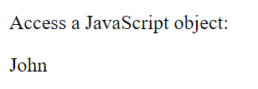
JSON Uses JavaScript Syntax
Example
var person = { name: "John", age: 31, city: "New York" };
<!DOCTYPE html>
<html>
<body>
<p>Access a JavaScript object:</p>
<p id="demo"></p>
<script>
var myObj, x;
myObj = { name: "John", age: 30, city: "New York" };
x = myObj.name;
document.getElementById("demo").innerHTML = x;
</script>
</body>
</html>
Output

Slide 12
JSON Data Types
a string
a number
an object (JSON object)
an array
a Boolean
null

Slide 13
JSON Numbers :
-Numbers in JSON must be an integer or a floating point.
{ "age":30 }
JSON Objects :Values in JSON can be objects.
{ "employee":{ "name":"John", "age":30, "city":"New York" } }
JSON Arrays
{ "employees":[ "John", "Anna", "Peter" ] }

Slide 14
JSON Booleans
{ "sale":true }
JSON null
{ "middlename":null }

Slide 15
JSON Outlines
JSON Parsing
JSON Stringify
JSON Object
JSON Array

Slide 16
JSON parse
A common use of JSON is to exchange data to/from a web server.
When receiving data from a web server, the data is always a string.
Parse the data with JSON.parse(), and the data becomes a JavaScript object.

Slide 17
Example - Parsing JSON
Imagine we received this text from a web server:
'{ "name":"John", "age":30, "city":"New York"}’
Use the JavaScript function JSON.parse() to convert text into a JavaScript object:
var obj = JSON.parse('{ "name":"John", "age":30, "city":"New
York"}');
Notes:
Make sure the text is written in JSON format, or else you will get a syntax error.

Slide 18
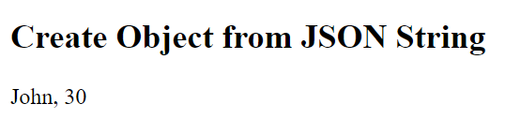
<!DOCTYPE html> output
<html>
<body>
<h2>Create Object from JSON String</h2>
<p id="demo"></p>
<script>
var txt = '{"name":"John", "age":30, "city":"New York"}'
var obj = JSON.parse(txt);
document.getElementById("demo").innerHTML = obj.name + ", " + obj.age;
</script>
</body>
</html>

Slide 19
Parsing Dates
Date objects are not allowed in JSON.
If you need to include a date, write it as a string.
Parsing Functions
Functions are not allowed in JSON.
If you need to include a function, write it as a string.

Slide 20
JSON stringify
A common use of JSON is to exchange data to/from a web server.
When sending data to a web server, the data has to be a string.
Convert a JavaScript object into a string with JSON.stringify().
object in JavaScript:
var obj = { name: "John", age: 30, city: "New York" };
Use the JavaScript function JSON.stringify() to convert it into a string.
var myJSON = JSON.stringify(obj);

Slide 21
Also
Stringify Array
Stringify Date
Stringify Function

Slide 22
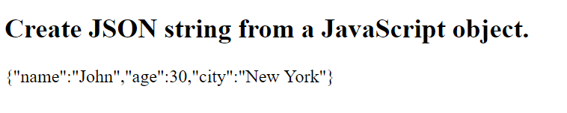
<!DOCTYPE html>
<html>
<body>
<h2>Create JSON string from a JavaScript object.</h2>
<p id="demo"></p>
<script>
var obj = { name: "John", age: 30, city: "New York" };
var myJSON = JSON.stringify(obj);
document.getElementById("demo").innerHTML = myJSON;
</script>
OUTPUT
</body>
</html>

Slide 23
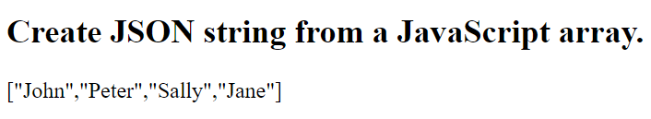
Stringify a JavaScript Array
<!DOCTYPE html>
<html>
<body>
<h2>Create JSON string from a JavaScript array.</h2>
<p id="demo"></p>
<script>
var arr = [ "John", "Peter", "Sally", "Jane" ];
var myJSON = JSON.stringify(arr);
document.getElementById("demo").innerHTML = myJSON;
</script>
OUTPUT
</body>
</html>

Slide 24
JSON data structure types
JSON objects
JSON objects in array
Nesting of JSON objects

Slide 25
JSON Objects
JSON objects are surrounded by curly braces {}.
JSON objects are written in key/value pairs.
Keys must be strings, and values must be a valid JSON data type (string, number, object, array, boolean or null).
Keys and values are separated by a colon.
Each key/value pair is separated by a comma.
Example
{ "name":"John", "age":30, "car":null }

Slide 26
JSON Object
var chaitanya = { "name" : "Chaitanya Singh",
"age" : "28",
"website" : "beginnersbook" };
Access information using JSON
document.writeln("The name is: " +chaitanya.name);
document.writeln("his age is: " + chaitanya.age);
document.writeln("his website is: "+ chaitanya.website);

Slide 27
Nesting of JSON objects:
var students = {
"steve" : {
"name" : "Steve",
"age" : "29",
"gender" : "male"
},
"pete" : {
"name" : "Peter",
"age" : "32",
"gender" : "male“
},
"sop" : {
"name" : "Sophie",
"age" : "27",
"gender" : "female"
}
}
document.writln(students.steve.age); //output: 29 document.writeln(students.sop.gender); //output: female

Slide 28
JSON objects in array
var students = [{
"name" : "Steve",
"age" : "29",
"gender" : "male"
},
{
"name" : "Peter",
"age" : "32",
"gender" : "male"
},
{
"name" : "Sophie",
"age" : "27",
"gender" : "female"
}];
document.writeln(students[0].age); //output would be: 29
document.writeln(students[2].name); //output: Sophie

Slide 29
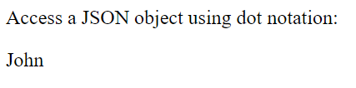
Accessing Object Values
<!DOCTYPE html>
<html>
<body>
OUTPUT
<p>Access a JSON object using dot notation:</p>
<p id="demo"></p>
<script>
var myObj, x;
myObj = {"name":"John", "age":30, "car":null};
x = myObj.name;
document.getElementById("demo").innerHTML = x;
</script>
</body>
</html>

Slide 30
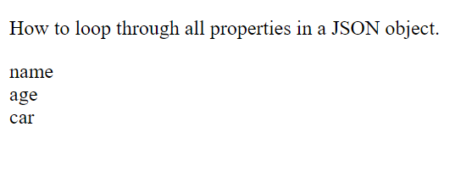
Looping an Object
<!DOCTYPE html>
<html>
<body>
<p>How to loop through all properties in a JSON object.</p>
OUTPUT
<p id="demo"></p>
<script>
var myObj = {"name":"John", "age":30, "car":null};
for (x in myObj) {
document.getElementById("demo").innerHTML += x + "<br>";
}
</script>
</body>
</html>

Slide 31
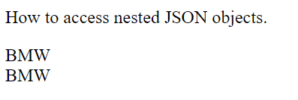
Nested JSON Objects
<!DOCTYPE html>
<html>
<body>
<p>How to access nested JSON objects.</p>
<p id="demo"></p>
<script> OUTPUT
var myObj = {
"name":"John",
"age":30,
"cars": {
"car1":"Ford",
"car2":"BMW",
"car3":"Fiat"
}
}
document.getElementById("demo").innerHTML += myObj.cars.car2 + "<br>";
//or:
document.getElementById("demo").innerHTML += myObj.cars["car2"];
</script>
</body>
</html>

Slide 32
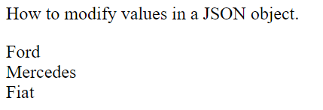
Modify Values
<!DOCTYPE html>
<html>
<body>
<p>How to modify values in a JSON object.</p>
<p id="demo"></p>
<script>
var myObj, i, x = "";
myObj = {
"name":"John",
"age":30,
"cars": { OUTPUT
"car1":"Ford",
"car2":"BMW",
"car3":"Fiat"
}
}
myObj.cars.car2 = "Mercedes";
for (i in myObj.cars) {
x += myObj.cars[i] + "<br>";
}
document.getElementById("demo").innerHTML = x;
</script>
</body>
</html>

Slide 33
Delete Object Properties
<!DOCTYPE html>
<html>
<body>
<p>How to delete properties of a JSON object.</p>
<p id="demo"></p>
<script>
var myObj, i, x = "";
myObj = {
"name":"John",
"age":30,
"cars": {
"car1":"Ford",
"car2":"BMW",
"car3":"Fiat"
}
}
delete myObj.cars.car2;
for (i in myObj.cars) {
x += myObj.cars[i] + "<br>";
}
document.getElementById("demo").innerHTML = x;
</script>
</body>
</html>

Slide 34
JSON Arrays
Arrays in JSON are almost the same as arrays in JavaScript.
In JSON, array values must be of type string, number, object, array, boolean or null.
In JavaScript, array values can be all of the above, plus any other valid JavaScript expression, including functions, dates etc.

Slide 35
Nested Arrays in JSON Objects
myObj = { "name":"John", "age":30, "cars": [ { "name":"Ford", "models":[ "Fiesta", "Focus", "Mustang" ] }, { "name":"BMW", "models":[ "320", "X3", "X5" ] }, { "name":"Fiat", "models":[ "500", "Panda" ] } ] }
Accessing Array
for (i in myObj.cars) {
x += "<h2>" + myObj.cars[i].name + "</h2>";
for (j in myObj.cars[i].models) {
x += myObj.cars[i].models[j] + "<br>";
}

Slide 36
Example
Design a web page to maintain a CD catalog. Maintain the name of music album, songs in that album, composer, singer and year of release. Format it in the tabular manner using XSL.
Generate xsl file for Student Database (Data must be as follow)
Student Name | Student address | Standard | Marks
Kavita | Pune | Second | 70
Aayush | Delhi | First | 80
Anurag | Mumbai | Forth | 88
Ruhi | Chennai | Tenth | 90

Slide 37
Example
Create a DTD for a catalog of four stroke motorbikes, where each motor bike has the following child elements – make, model, year, colour, engine, chasis number and accessories. The engine element has the child elements engine number, number of cylinders, type of fuel. The accessories element has the attributes like disc brake, auto-start and radio, each of which is required and has the possible values yes and no. Entities must be declared for the names of the popular motorbike makes.

